Slide 1


Capstone Project 1 Movie Recommendation Engine
Capstone Project 1
Amin Yaesoubi
Springboard
Data Science Career Track
December 2019

Slide 2
Overview
Nowadays, we need recommender systems almost everywhere in our lives.
Retailers are become more interested in recommender.
Systems to analyze patterns of user interest in products and provide personalized recommendations.
Since we want to work with movie dataset, the client of this project could be Amazon, Netflix, Hulu, HBO, etc.
Giving good recommendations will help users spend less time searching for their type of movie and having a recommender platform.
This will help the customer to continue with the service and having a good experience.

Slide 3
Data
We will be using the MovieLens dataset for this purpose. It has been collected by the GroupLens Research Project at the University of Minnesota. MovieLens 100K dataset consists of:
100,000 ratings (1-5) from 943 users on 1682 movies.
Each user has rated at least 20 movies.
Simple demographic info for the users (age, gender, occupation, zip)
Genre information of movies

Slide 4
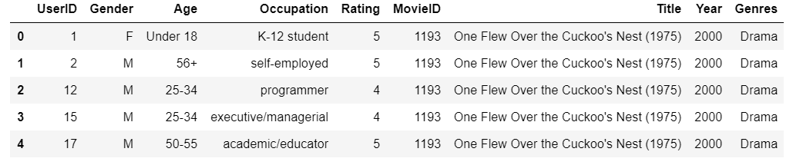
Data Wrangling
We conduct the following steps to clean up data and pick useful features.
1- Merge all 3 tables to one table and mapped each column which has code to real data and picked useful columns for further analysis
2- Search for missing values and filling them with appropriate value like mean
3- Finding outliers & Fix then
Trying to find outliers and check the values if they are in the scope or not? For example, “Ratings” data frame, has one column ‘Rating’ which must have a value between 1 to 5, and apply command “.groupby(‘Rating’)” to data frame and check this column has any other value other than 1 to 5 or not? If yes, replace with appropriate value.
4- Drop duplicates

Slide 5
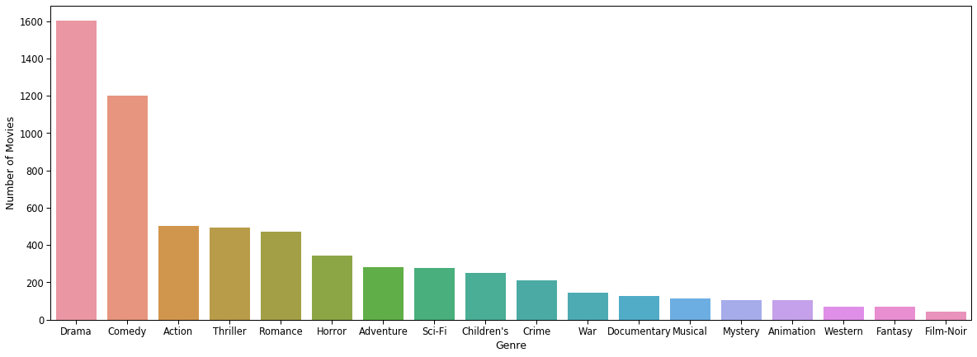
Data Exploration
Distribution of movies in each genre

Slide 6
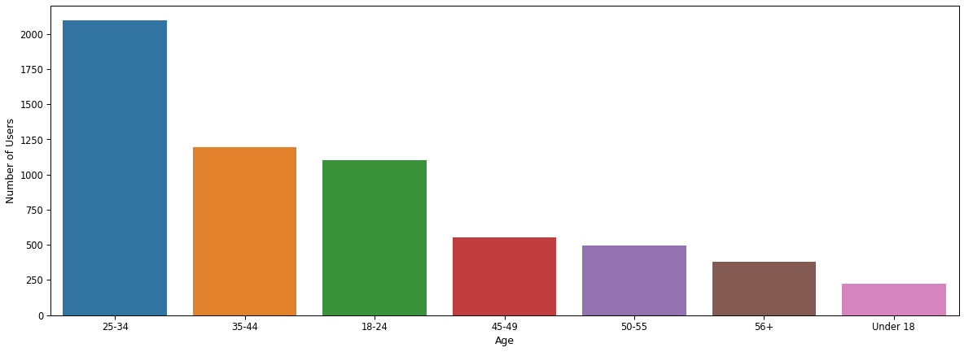
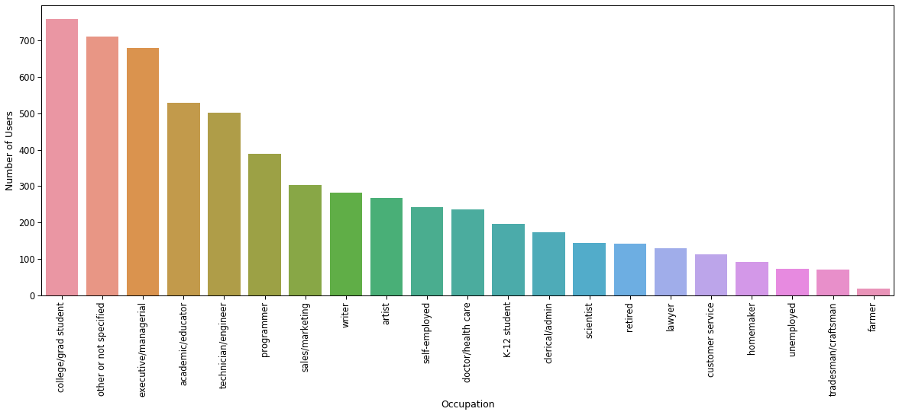
Data Exploration
Distribution of users in each age group and in each occupation

Slide 7
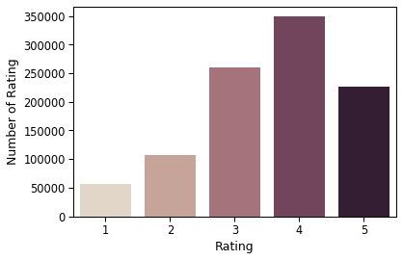
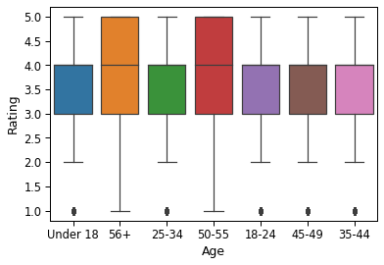
Data Exploration
Distribution of ratings

Slide 8
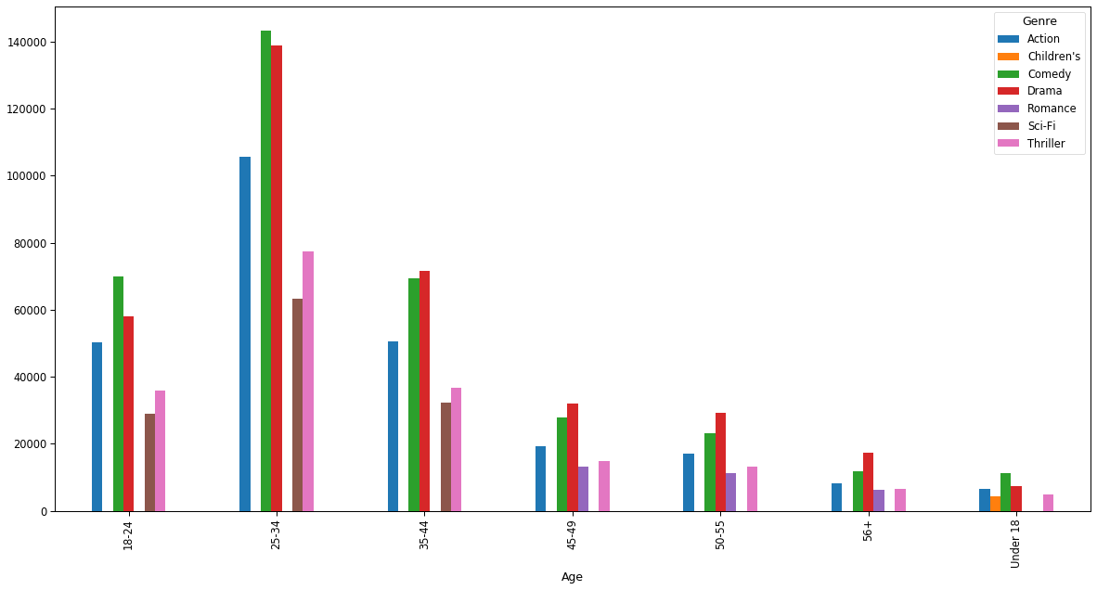
Data Exploration
Distribution of rating of most 5 popular genres in each age group

Slide 9
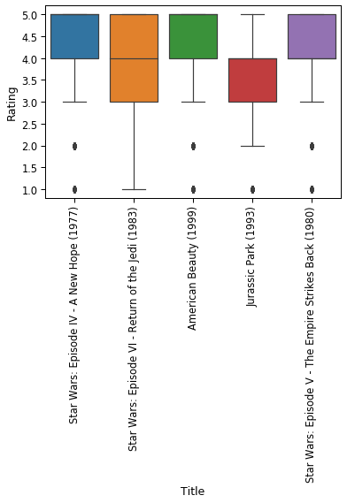
Data Exploration
Distributation of rating for top five movies in dataset

Slide 10
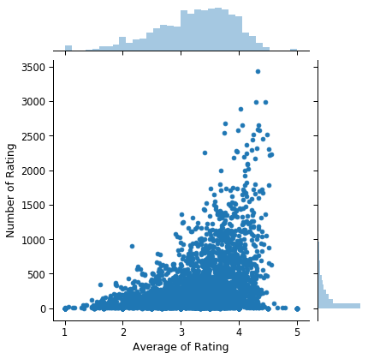
Data Exploration
Correlation between number of ratings and average of ratings

Slide 11
Machine Learning: Overview
Random Forest (RF) was used to find out important features and reduce dimensionality
XGBoost was used for prediction
Overall strategy:
Get 1% of data as a sample.
Use Random Forest to find out important components and reduce dimensionality
Use XGBoost on important components of all data.
Split the data into training and test datasets
Train various learning models, with cross-validated hyperparameter tuning
Apply the models to the test dataset to get measures of performance

Slide 12
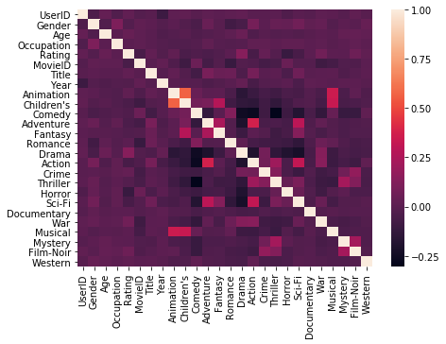
Machine Learning: Heatmap
Correlations between features

Slide 13
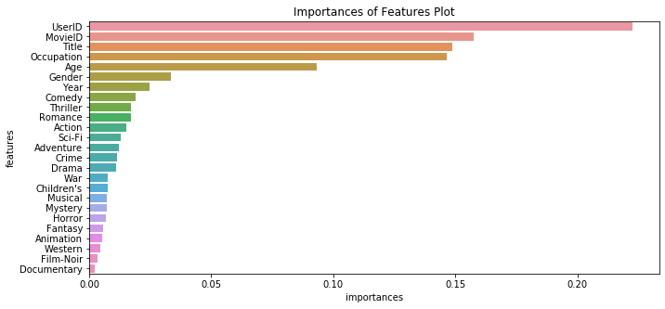
Machine Learning:RF
Selected the most informative columns using Random Forest Model.

Slide 14
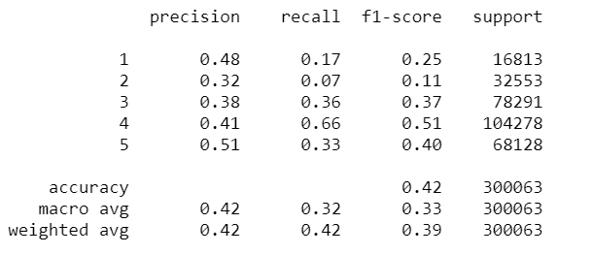
Machine Learning: XGBoost
The best estimator was selected by Randomized Grid Search with Stratified Shuffle Split Cross Validation.
The best hyperparameters included a tree count of 250, max depth of 10, and allowing trees to consider all features
The results of the algorithm

Slide 15
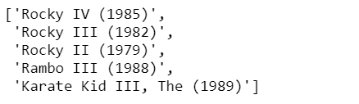
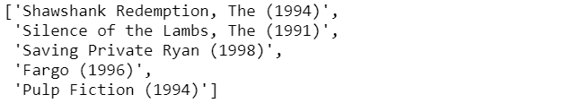
Recommender System

